Slide 1

Our Topics: Visualization That Really Works The Quick and Dirty on Visualization
Group 5
Prithvi Chauhan (PXC210028)
Sri Pallavi Chittimalla (SXC200107)
Sai Jahnavi Potu ( SXP210280)
Sharon Lnu (SXL220024)
Arjun Singh Pathania (AXP220145)
Sri Harsha Vardhan Koduri (SXK210338)

Slide 2
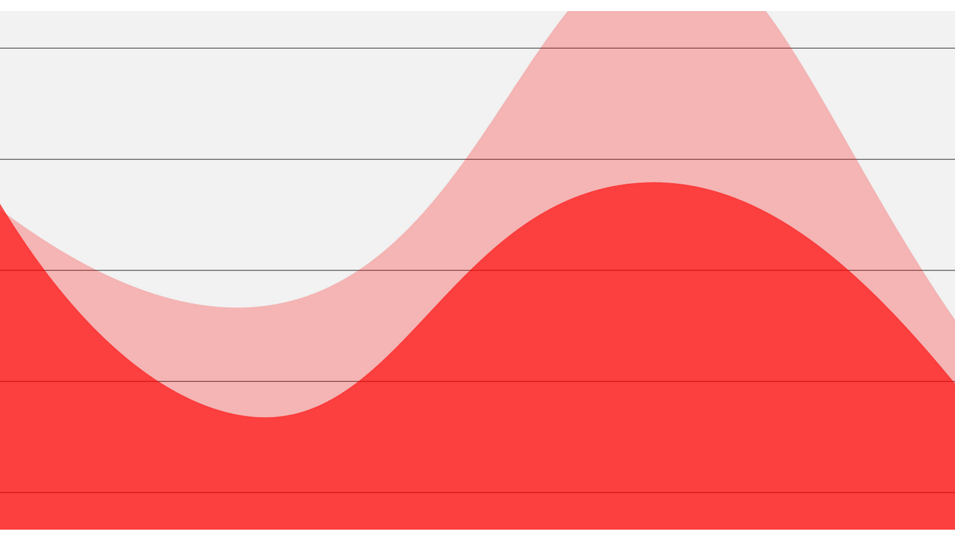
Visualizations That Really Work
Effective data visualizations are essential for communicating complex information in a clear and accessible way. Here are some types of visualizations that have been shown to be effective:
Bar charts: Bar charts are one of the most widely used and effective types of visualizations. They are easy to read and provide a clear comparison between different categories or data points.
Line charts: Line charts are another common and effective visualization, especially when showing trends over time. They are also useful for comparing different groups or categories.
Scatter plots: Scatter plots are useful for showing the relationship between two variables. They are often used in scientific research to show the correlation between two sets of data.
Heat maps: Heat maps are a way of visualizing large amounts of data by color-coding it. They are especially useful for showing patterns and trends in geographic data or in large datasets.

Slide 3
Learning Objectives
Understanding the significance of producing successful visualizations that concisely and clearly communicate insights is important
Learn how to begin visualizing and what concepts to keep in mind
Learn how does visualization aid in the resolution of complex issues?
Understand The purpose and importance of visual discovery

Slide 4
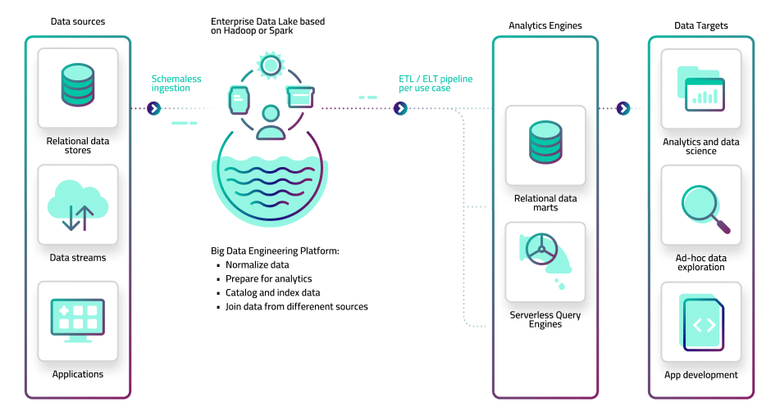

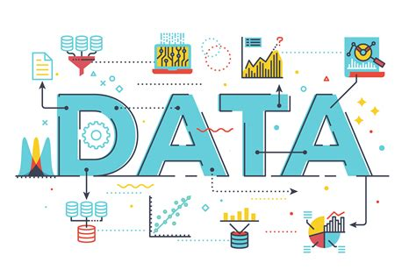
Visualization that really works
Previously: Nice skill to have
Now: Must have skill
Why?
Large volume of data
High velocity of data
Affordable tools
Internet
Issues?
Convenient results in graphics that are barely sufficient or, worse yet, ineffectual.
The idea, not the numbers, is what we're after!
Visual communication is not a single action but rather a collection of related acts, each requiring a unique set of planning, resources, and abilities.

Slide 5

How and Where to start?
Is the information conceptual or data-driven?
Notice that the query is not about the forms you might use to display the information, but rather the information itself.
The following two categories of representations:
Quantitative Data: Analyzing huge numerical data
Qualitative Data: Highlighting core ideas and the lending environment
Am I declaring something or exploring something? If the first question identifies what you have, the second elicits what you’re doing:
Declarative- Communicating Information
Exploratory- Trying to figure something out
Notes:
Before starting any visualization we need to know where and how to start. For this it is always better to ask yourself 2 questions.
Is the information conceptual or data driven and Am I declaring something or exploring something.
If you know the answers to these questions, you can plan what resources and tools you’ll need and begin to discern what type of visualization will help you achieve your goals most effectively. Let’s dig deep into each question.
The first question is the simpler of the two and easy to answer. Either you’re visualizing qualitative information or you’re plotting quantitative information: ideas or statistics. Note that the question is about the information and not the forms of charts or depictions you will ultimately use.
Visualizing quant data is about helping others digest large data sets and raw numbers in a way that’s easier to interpret into action. It is easier to depict, harder to analyze.
Qualitative data visualization is all about depicting key themes, building connections, and lending context. It is less intuitive to human brain.
The second question elicits what you are doing. Either you are communicating information (declarative) or trying to figure something out (exploratory)

Slide 6
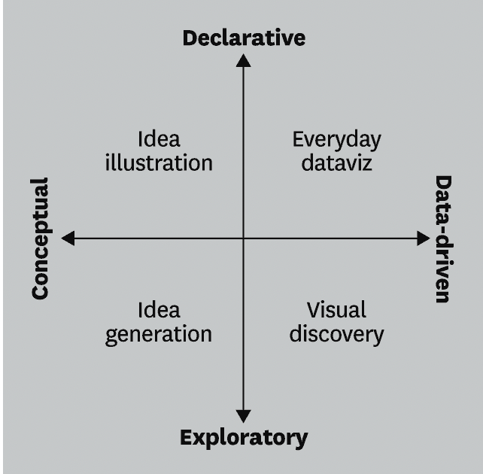
The questions about the nature and purpose of visual communication can be used to create a 2x2 matrix that defines four different types of visual communication. These four types are:
Idea illustration, which involves using visual communication to clarify and explain ideas.
Idea generation, which involves using visual communication to generate new ideas and explore possibilities.
Visual discovery, which involves using visual communication to analyze and interpret data and uncover new insights.
Everyday data visualization, which involves using visual communication to present data in a clear and accessible way for everyday use.

Slide 7
Idea Generation
This information appears to be describing a type of working session or meeting that involves complex and undefined information, typically used for brainstorming.
The primary skills required for this type of session are team-building and facilitation, with the main goals being problem-solving, discovery, and innovation.
In such a session, the focus is on exploring new ideas and solutions to complex problems, often with little or no pre-defined structure or guidance.
The session may involve a diverse group of individuals with different backgrounds and areas of expertise, who are brought together to collaborate and share ideas.

Slide 8

The use of visualization as an idea generation tool is a powerful way to help individuals work through complex problems and generate new ideas
The use of visualization in this context relies on the power of visual representation to help individuals work through complex or ambiguous ideas.
This process of visualization can help individuals to move from ambiguity to clarity by breaking down complex information into more manageable pieces.
As they work through the visual representation, they may identify new patterns or connections, leading to new insights and ideas.

Slide 9
Idea illustration
This information describes a process or framework that is typically used in a presentation or teaching setting.
The main goals of this process or framework are learning, simplifying, and explaining complex information.
The process or framework is designed to make complex information more accessible and easier to understand for an audience.
The process may also involve editing and simplifying complex language or ideas, so that they are more easily digestible for the audience.
The primary skills needed for success in this process or framework include design and editing.

Slide 10

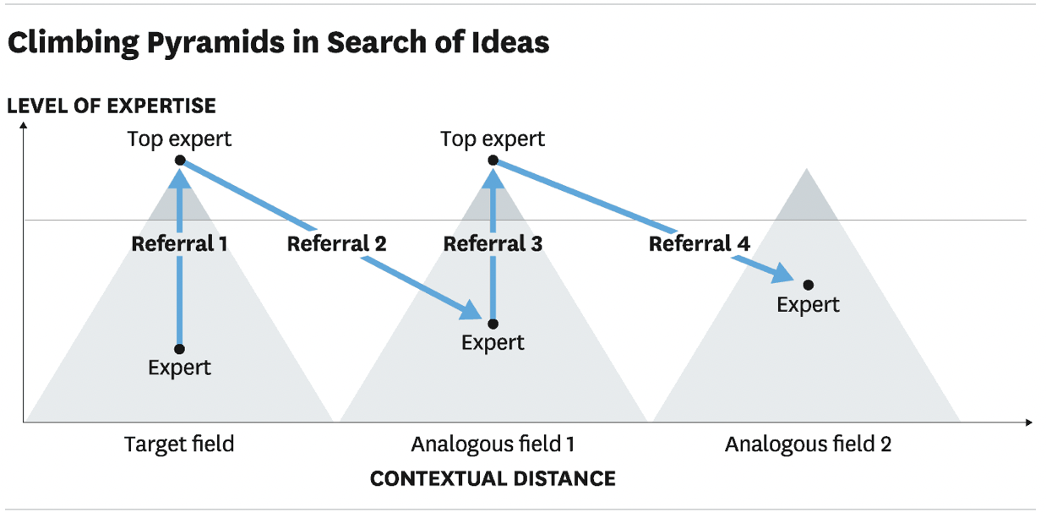
Idea Illustration
Example – Company has engaged their Consultants to help its R & D Team to find inspirations in other industries

Slide 11
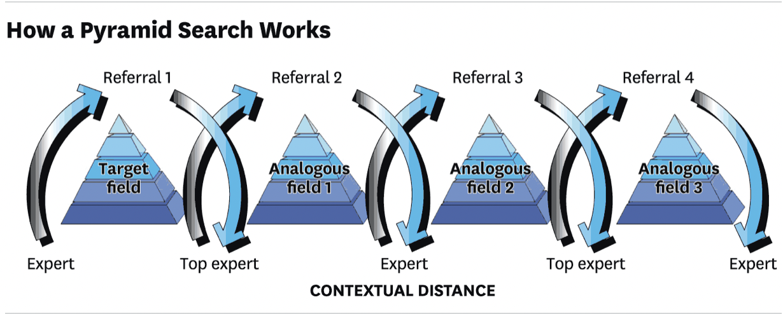
What if Idea Illustration does not go well?

Slide 12
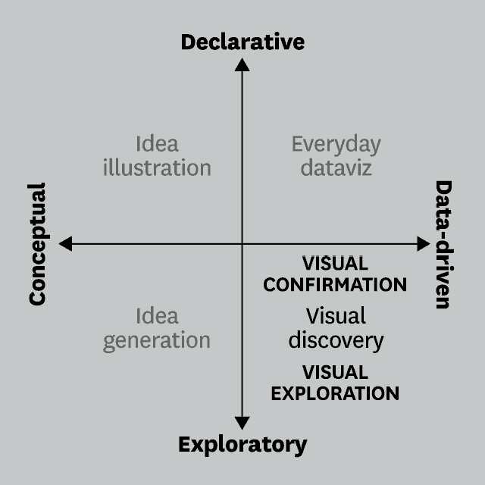
Visual Discovery
This information describes a type of data analysis that involves big data, which is complex and dynamic.
This type of analysis is typically conducted in a working session setting, such as during testing or analysis.
The primary skills required for this type of analysis are business intelligence, programming, and paired analysis, which involves two people working together to analyze the data.
The main goals of this type of data analysis are trend spotting, sense-making, and deep analysis.

Slide 13

Visual Discovery
Visual discovery is one of the four quadrants of visual communication , and it is the quadrant where business analyst often work the most
The purposes of visual discovery can be separated into two types: .
Testing a hypothesis
Mining for patterns, trends, and anomalies.
Testing a hypothesis is more focused, while mining for patterns, trends, and anomalies is more flexible.
When conducting visual discovery, the questions that Business Analysts are trying to solve include "what I suspect is true" and "what are some other ways of depicting this idea
Choosing chart types is an important aspect of visual discovery, and Business Analysts typically use mostly common charts
The skills needed for visual discovery include manipulating spreadsheets, as well as having knowledge of programs or sites that enable swift prototyping

Slide 14
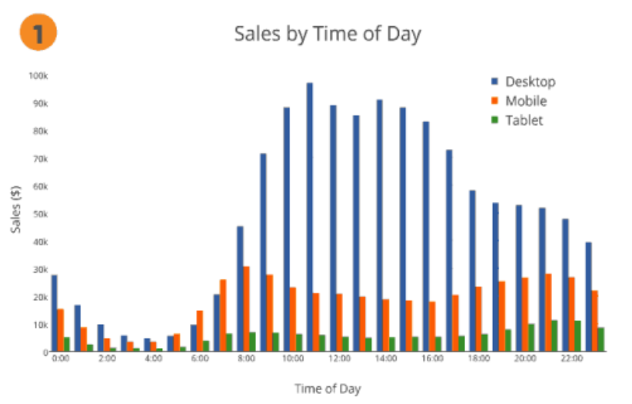
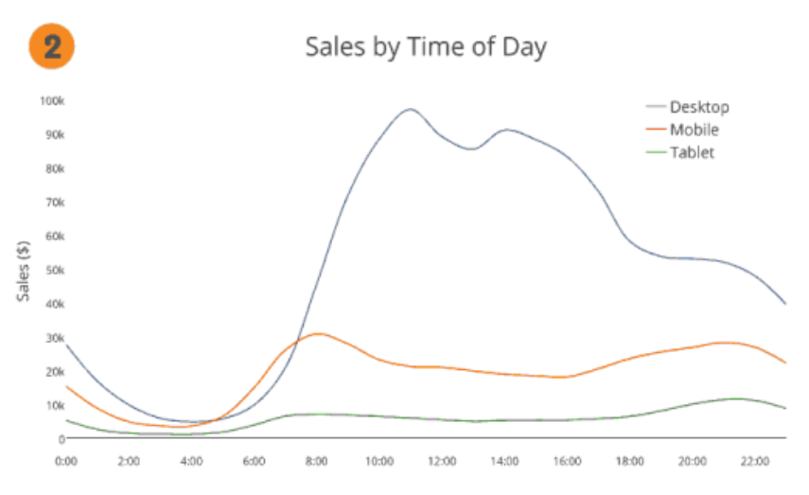
Visual Discovery
Hypothesis by marketing manager: At certain times of the day more customers shop mobile devices than on desktops

Slide 15
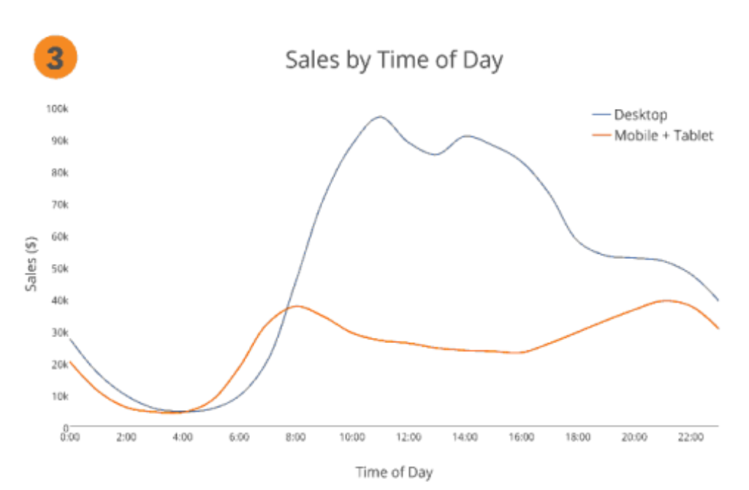
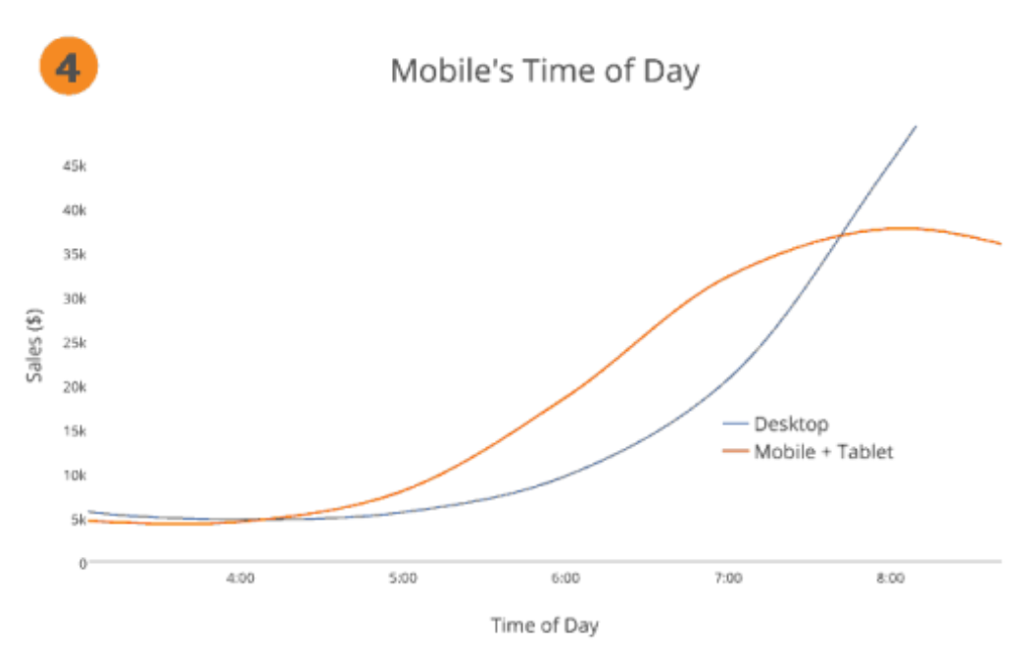
Visual Discovery
Hypothesis by marketing manager: At certain times of the day more customers shop mobile devices than on desktops

Slide 16
Everyday DataViz
This information describes a type of information that is simple and low in volume.
This type of information is typically presented in a formal setting, such as during a presentation.
The primary skills required for its effective communication are design and storytelling.
The main goals of presenting this type of information are to affirm existing knowledge and set the context for the audience

Slide 17
Everyday DataViz
Sits in the quadrant between data-driven and declarative.
Basic charts and graphs that may be made in Excel, most commonly in the form of
Bar graphs
Line graphs
Pie charts
Scatter charts, fall under this category.
The main purpose of Data visualization is to offer accurate information in an easy-to-understand way.
The emphasize is on providing clear and concise message that is quickly understood by the audience, rather than overwhelming them with to much data or cluttered graphics.
The Data Driver declarative visualization strives to remove potential issues by making the chart peak for itself and stimulating content discussion.

Slide 18
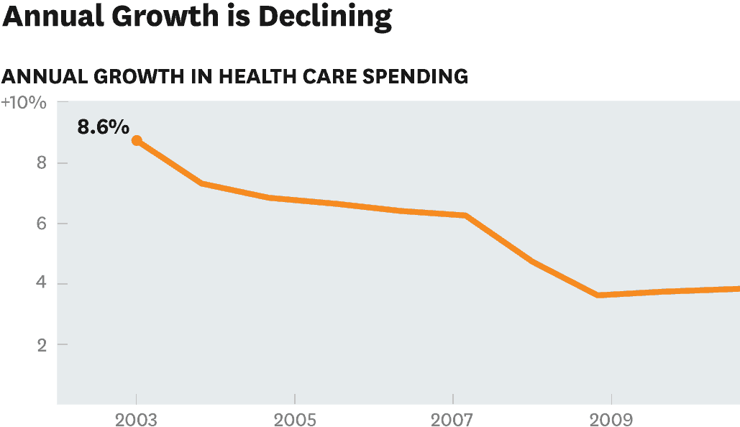
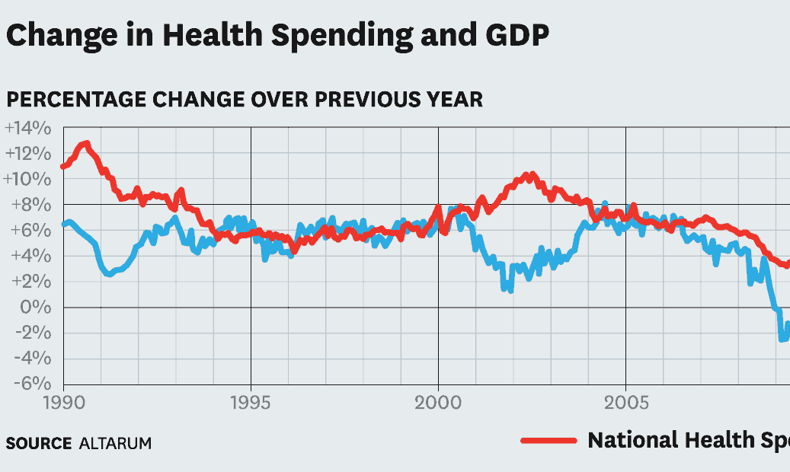
Everyday DataViz
Typical example – HR VP of a company wants to convey that company’s health care costs have slowed significantly, creating an opportunity to invest in additional health care services.

Slide 19
Learning Outcomes
Students will be able to :
recognize and appreciate the importance of creating successful visualizations that effectively communicate insights in a clear and concise manner
Apply key concepts and strategies to begin the process of visualizing data and will be able to identify important factors to consider when creating visualizations
Describe how visualization techniques can be used to resolve complex issues and effectively communicate insights to stakeholders
Explain the purpose and importance of visual discovery in the process of analyzing and communicating data

Slide 20

The Quick and Dirty on Data Visualization

Slide 21
Learning Objectives
Understand the importance of context in displaying data
Identify the appropriate type of chart or table to use for different types of data
Learn how to highlight the most important elements of the data to convey a clear message
Ensure accuracy in visual representations of data
Explore strategies for making data memorable through the use of visual metaphors

Slide 22
The quick and dirty on data visualization
Data visualization can be difficult since various principles apply in different situations.
Before presenting your data, consider the following five questions:
1. Am I presenting or circulating my data?
2. Am I using the right kind of chart or table?
3. What message am I trying to convey?
4. Do my visuals accurately reflect the numbers?
5. Is my data memorable?

Slide 23
Am I presenting or circulating the Data?
Providing context can help the audience understand why the data is important, what it represents, and how it relates to the topic or problem being discussed.
It's important to present conclusions and key insights, It is more effective to utilize a general approach that emphasizes the primary trends and the most notable comparisons.
It is crucial that the audience can swiftly comprehend the information presented. They should be able to grasp the facts almost instantly as the slide appears.

Slide 24

How do we do this??
We need to reflect on issues such as :
What must be underlined in terms of trends? (Incremental prediction of pumpkin sales around Halloween)
What variables need to be compared? (Sales vs Profit)

Slide 25
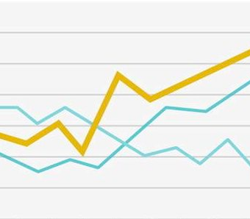
Using design elements such as grid lines, legend, and tick marks can help the audience understand the data better.
Choosing a light neutral colour for the background can help to make the data and design elements more visible.
Using brighter colours to emphasize certain data points or trends can also be effective, as long as it is done sparingly and with purpose

Slide 26
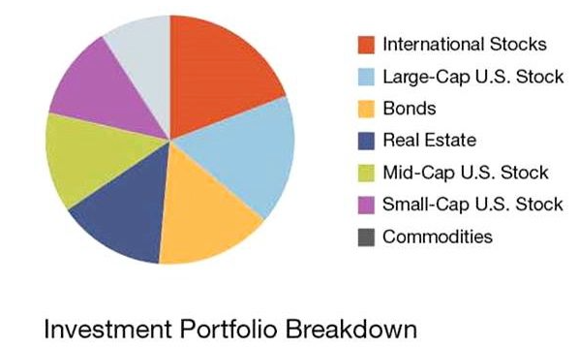
Am I using the right kind of chart or table?
When choosing how to visualize data, it's important to consider what information you want to communicate and what type of chart or graph will be most effective for that purpose.
Pie charts can be useful for showing how a whole is divided into different parts, such as how an investment portfolio is allocated across various sectors or asset classes.

Slide 27
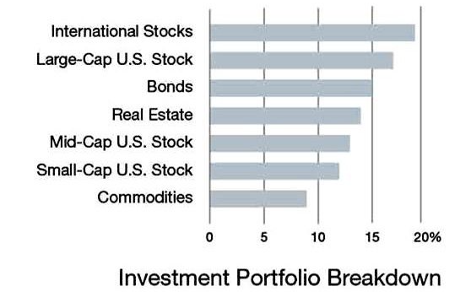
A bar chart can be an effective way to display the same data that is shown in a pie chart, but with a different emphasis.
But it’s easier to see how much money is invested in each category, as the height of each bar directly corresponds to the value of that category. This can be particularly useful when comparing the relative size of each category, as it is easier to make precise comparisons between different heights than it is to compare different-sized slices of a pie.
A pie chart can be useful when trying to show the relative size of a single investment compared to the overall portfolio.

Slide 28
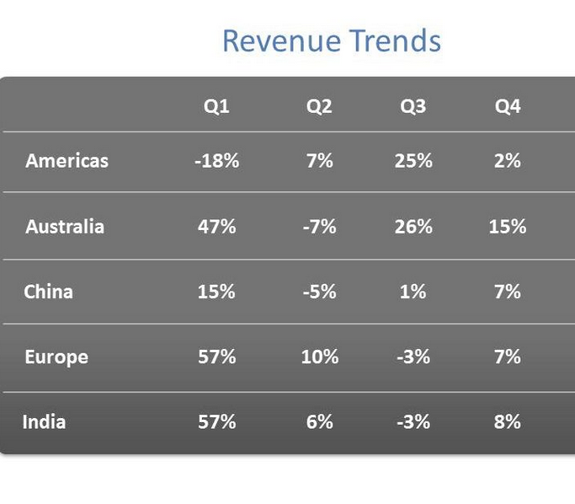
What message am I trying to convey?
While presenting the charts it is important to highlight important points in your charts and graphs to help guide the audience's attention to the most important information.
One way to do this is to use visual cues such as bolding, colour, or size to make the key information stand out.
What are we comparing here?
→ Quarters?
→ Positive vs Negative growth?

Slide 29
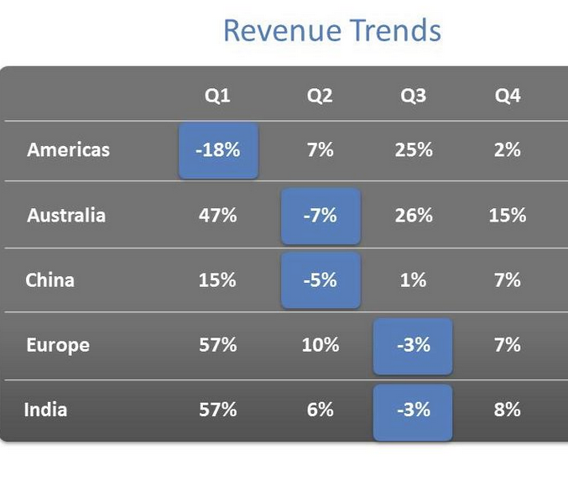
Highlighting the data points in the chart can help in this case.
It should be noted that the highlighted points must be brighter than the background.

Slide 30
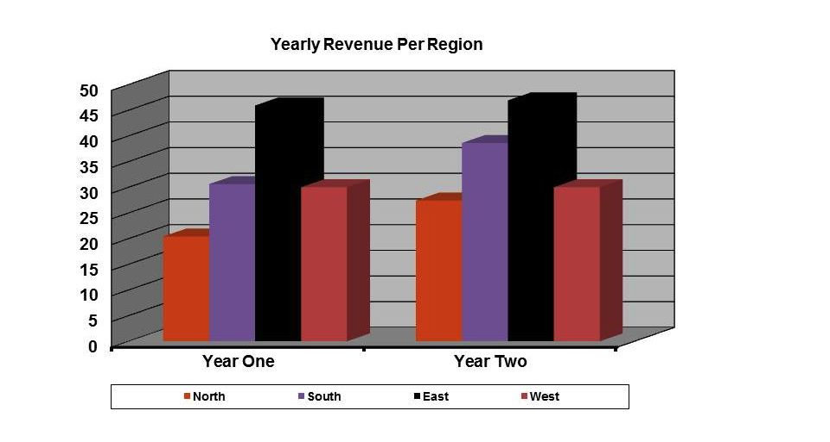
Do my visuals accurately reflect the numbers?
Using too many crazy colours, extra labels, and fancy effects can distract and overwhelm your audience, making it more difficult for them to focus on the important information.
Northern territory’s revenue for year one, Is it 17 or 19?

Slide 31
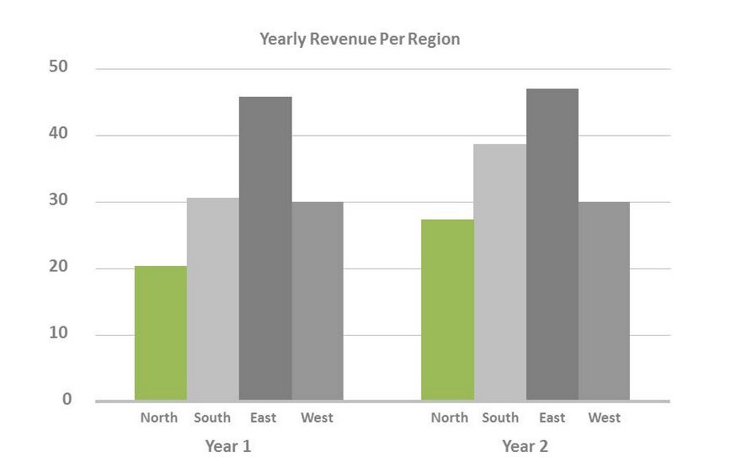
Rather than using too many colours, labels, and effects, it can be better to use a clean and simple design to communicate the key information effectively.

Slide 32
Is my data memorable?
Making information stick with your audience can be a challenging task, even if you have presented the facts in a clear and concise manner.
Use repetition: Repeating important information or key points throughout your presentation can help reinforce those concepts and make them more memorable
Use visuals: Visual aids, such as diagrams, graphs, and images, can help break up the text and make your information more engaging and memorable.
Use storytelling: People are more likely to remember information that is presented in the form of a story.
Use analogies: Analogies can help make complex ideas more accessible and easier to understand.

Slide 33
Are my data memorable?
Imagine a series of mountains representing different values or quantities. Each mountain represents a different data point or category, and the height of the mountain represents the magnitude or value of that data point.
By using this metaphor, you can visually demonstrate the scale and magnitude of the data in a way that is easy to understand and remember.
A metaphor can be a powerful tool to help your audience understand and connect with your ideas by using something they already know and care about.

Slide 34
Learning Outcomes
Evaluate the context in which data will be presented or circulated and decide how to best render the data in a way that is easy for the audience to understand.
Choose the appropriate type of chart or table based on the type of relationship being emphasized and the message being conveyed.
Highlight the most important items in the data to ensure the audience can follow the train of thought and focus on the right elements.
Ensure that visuals accurately reflect the numbers and avoid using unnecessary visual clutter that may dilute or misrepresent information.
Create memorable data visuals by using meaningful visual metaphors that trigger a visceral response and tie insights to something the audience already knows and cares about.

Slide 35

QUESTIONS?

Slide 36

Thank you

